Slide 1
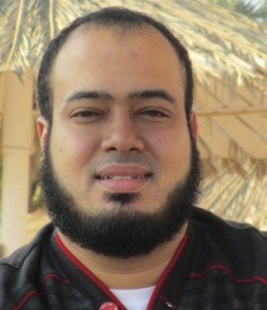
Competitive Programming From Problem 2 Solution in O(1)
P
T
H
I
N
K
F
A
S
T
S
Mostafa Saad Ibrahim
Teaching Assistant @ Cairo University

Slide 2
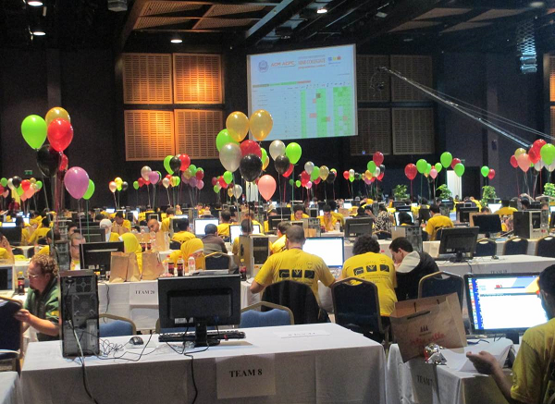
ACM ACPC

Slide 3
Agenda
Competitive Programming Prerequisites
Core advices
Discipline Monitor Approach
Junior Training
Semi-Senior Training
Discipline Monitor into action
Moving to toward Seniority
Last advice

Slide 4
Competitive Programming Prerequisites
Basic Programming Knowledge
Variables, Conditions, Arrays, Loops, Functions, Recursion, STL
C++ Structure / Basic Class
How to handle Files (Basic read / write operations)
Nothing more (e.g. No OOP, operator overloading…)
Programming Practice
Solve much exercises on learnt concepts
C++ for Programming Competitions Series

Slide 5
Best advices
Step 1: Practice
Step 2: Go to step 1
Challenge spirit…compete against others

Slide 6
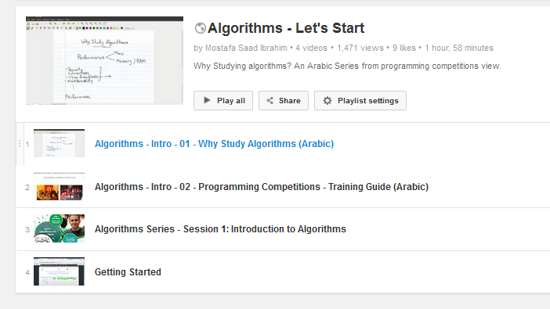
Starting

Slide 7
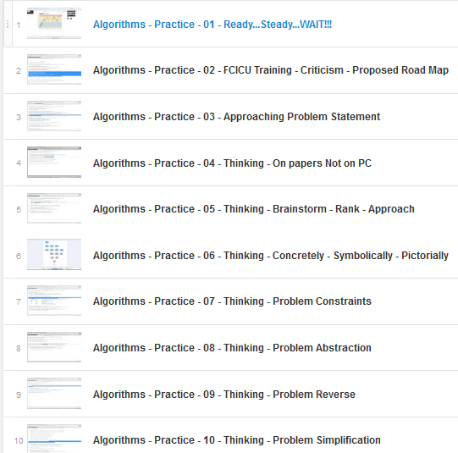
How to Practice YouTube Series
Won’t be so helpful 4 Juniors
But will help when grow
Listen to 1 video every week

Slide 8
Monitor Discipline Approach
A simple approach to boost performance
Last video in how to practice series
Build Disciplines
Apply them
Monitor -> Evaluate -> Update Disciplines

Slide 9
The Discipline
Discipline = Behaving Systematically
One way = checklist
Develop discipline for everything!
Problem phases (Reading, thinking, solving...)
Contest Strategy

Slide 10
The Monitor
Followed discipline?
Discipline achieves its targets?
How to build it? Update it?

Slide 11
Phase 1: Junior Training
Knowledge
Don’t read ANY algorithms
Solve TopCoder Problems Div2 – 250
From SRM 300 to 400
Compete in all online SRMs / CodeForces.
Move to Next level: when online score avg ~ 230

Slide 12
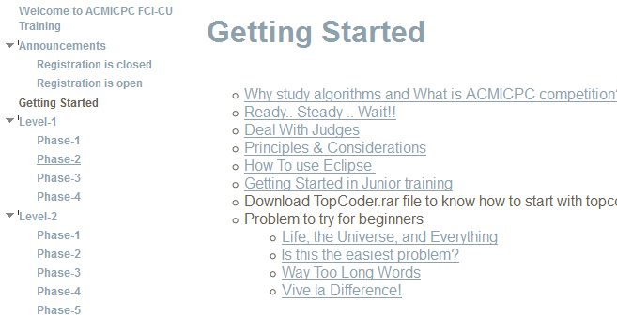
Or better follow acmicpcfcicu
https://sites.google.com/site/acmicpcfcicu/home

Slide 13
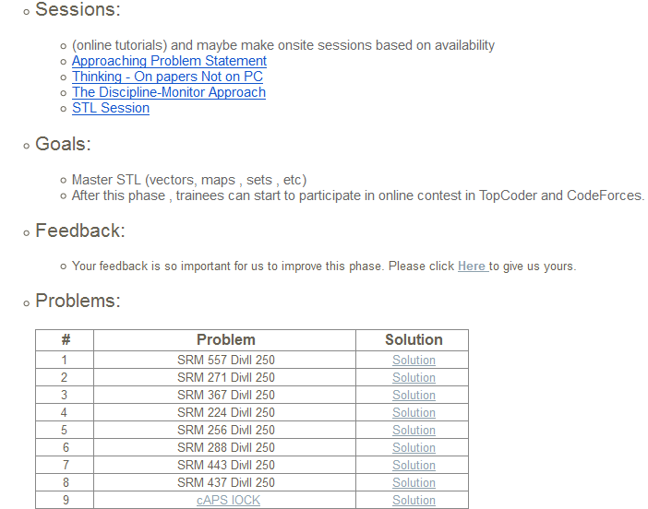
Or better follow acmicpcfcicu

Slide 14
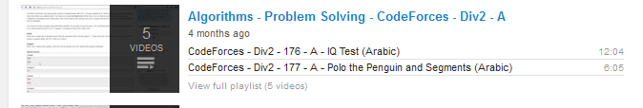
Mind Process

Slide 15
Phase 2: Semi-Seniors
Similar to Phase 1 (or Level 1, 2 in acmicpcfcicu)
Learn little more knowledge
Move one step up (e.g. Div2 – 500)
Stop when avg Score ~ 400
You could depend on problems order in my Junior Training

Slide 16
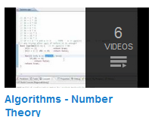
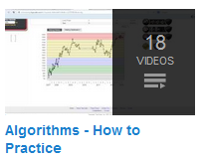
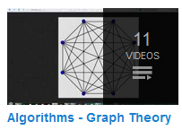
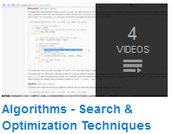
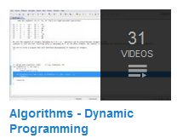
Phase 2 - Knowledge
First 4 videos
First 3 videos
First 8 videos

Slide 17
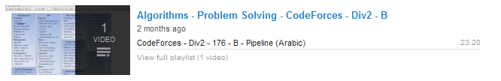
Mind Process

Slide 18
Monitor Discipline into action
Putting Approach into action
Problems Match ZPD
Measure for progress
Logging for Monitoring
Disciplines to follow
Google Sheet Link (Click File-> Make a Copy)
http://goo.gl/Qgyskz

Slide 19
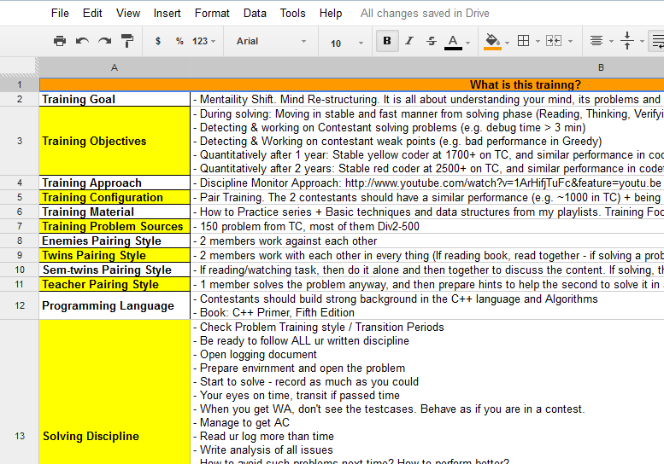
Monitor Discipline Training

Slide 20
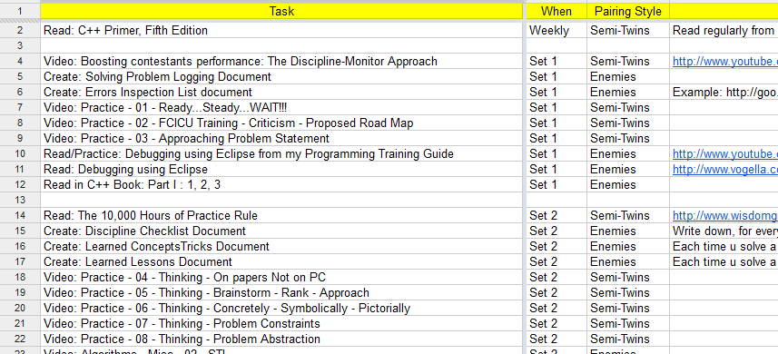
Tasks Sheet

Slide 21
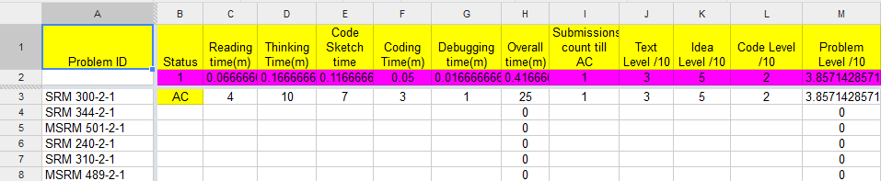
Measures

Slide 22
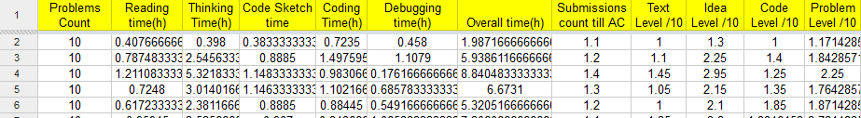
Statistics

Slide 23
Documents to develop
3 documents to develop
Mind Logging: During solving a problem, log every thing with time
Discipline: Write checklists to follow. Investigate Mind logging to know your problems
Error Inspection List: Each time you do new bug, record it

Slide 24

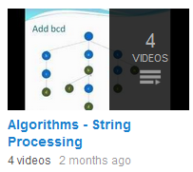
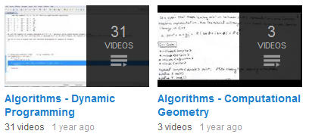
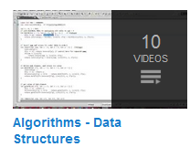
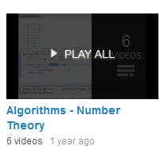
Moving to toward seniority
Passed Phase 1 & 2 = thinking engine
Start to learn more algorithms
+
Move to higher (e.g. Div2-1000
Or CodeForces Div2-C)
……
Give much attention to the thinking series

Slide 25
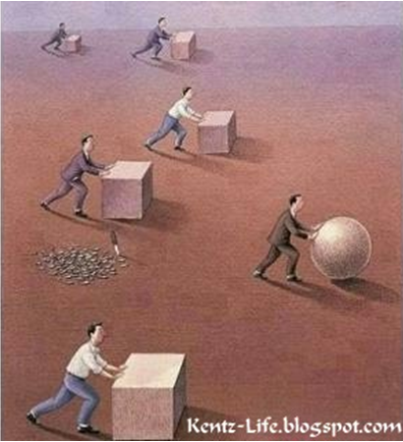
Hard Vs Smart Work
Same Contestant + Hard Work
<
Same Contestant + Smart Work
Think much about your training
Weak Points
How to improve..etc
After year you could be on e.g TC
Green
Blue
Yellow
Same person!

